Slide 1
8.4 Recommender Systems

Slide 2
In this Section we discuss the fundamental linear Recommender System, a popular unsupervised learning framework commonly employed by businesses to help automatically recommend products and services to their customers.
From the vantage of machine learning however, the basic Recommender System detailed here is simply a slight twist on our core unsupervised learning technique: Principal Component Analysis (PCA).

Slide 3
Introduction and motivation

Slide 4
Recommender systems are heavily used in e-commerce today, providing customers with personalized recommendations for products and services by using a consumer's previous purchasing and rating history, along with those of similar customers.
For instance, a movie provider like Netflix with millions of users and tens of thousands of movies, records users' reviews and ratings (typically in the form of a number on a scale of 1-5 with 5 being the most favorable rating) in a large matrix such as the one illustrated below in the Figure.
These matrices are very sparsely populated, since an individual consumer has likely rated only a small portion of the movies available.

Slide 5
With this data available, online movie and commerce sites often use the unsupervised learning technique we discuss in this Section as their main technique for making personalized recommendations to customers regarding what they might like to watch / consume next.
With the technique for producing personalized recommendations we discuss here - typically referred to as a Recommender System - we aim to intelligently guess the values of every missing entry in the ratings matrix (we complete the matrix).

Slide 6
Then, in order to recommend a new product to a given user, we examine our completely filled ratings matrix for products we have predicted the user would highly rate (and thus enjoy) and recommend these.

Slide 7
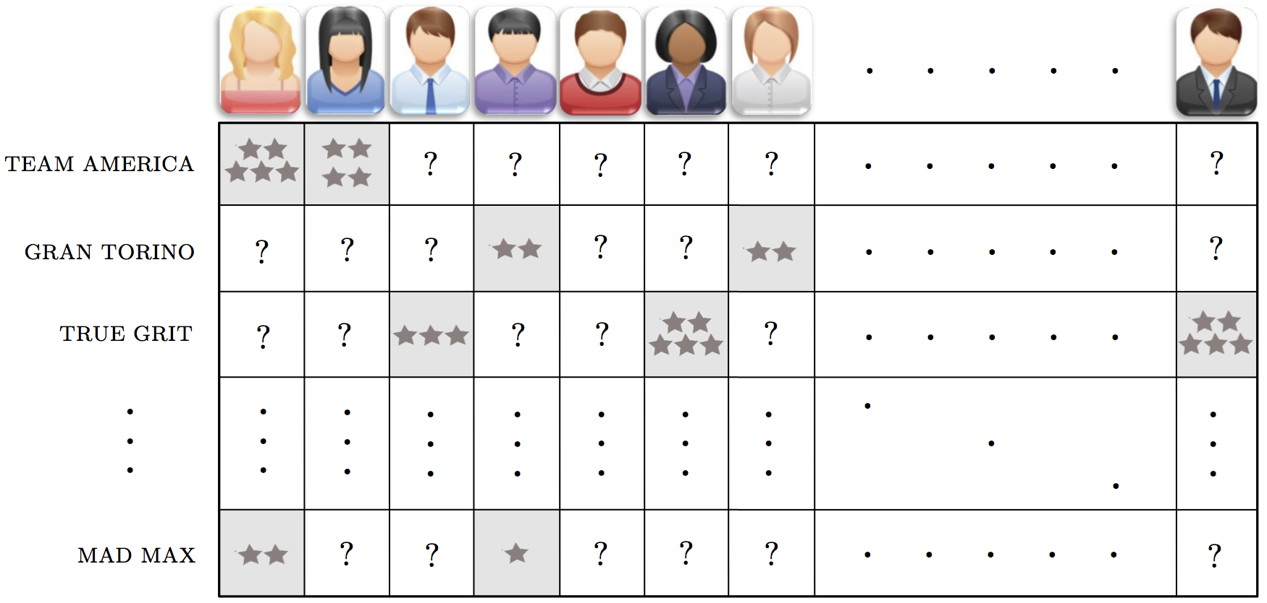
A prototypical movie rating matrix is very sparsely populated, with each user having rated only a very small number of films.

Slide 8
Formal modeling

Slide 9
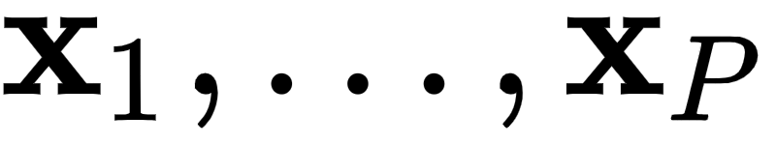
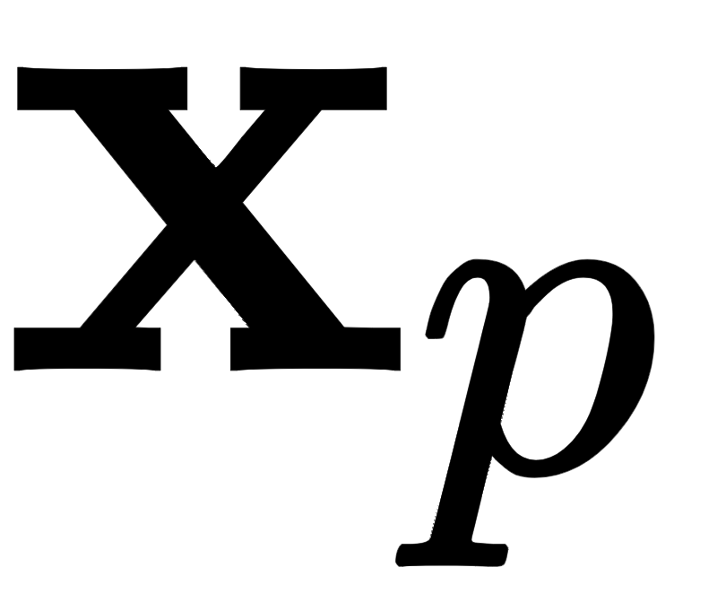
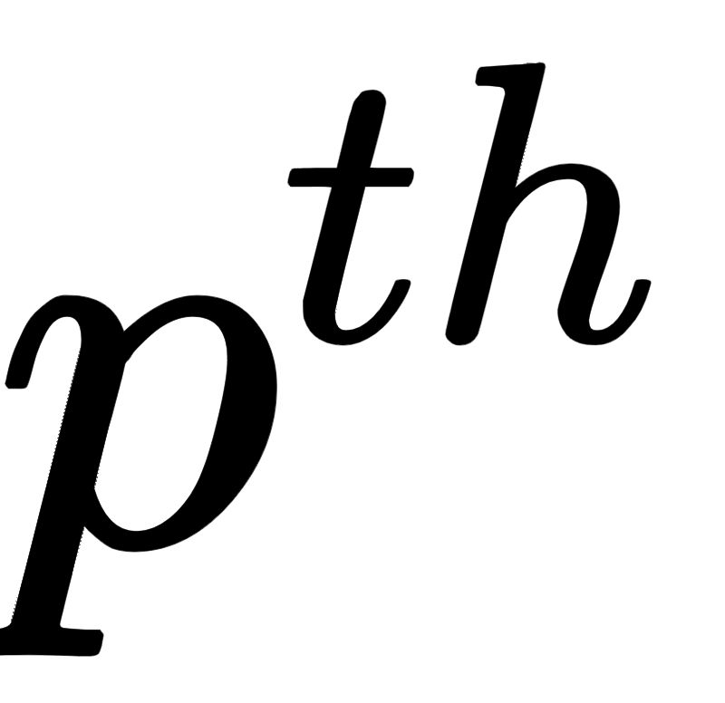
In what follows we will use the familiar notation to denote our input data, each of which has dimension N.
Here is our user's rating vector of - and is N dimensional where N is the total number of products / services available to be rated - and each is very sparsely populated (with whatever ratings user p has input into the system).

Slide 10



Formally we can denote the index set of those products / services the user has rated - or in other words the index set of those non-empty entries of - as
Note here that denotes the entry of the vector .

Slide 11
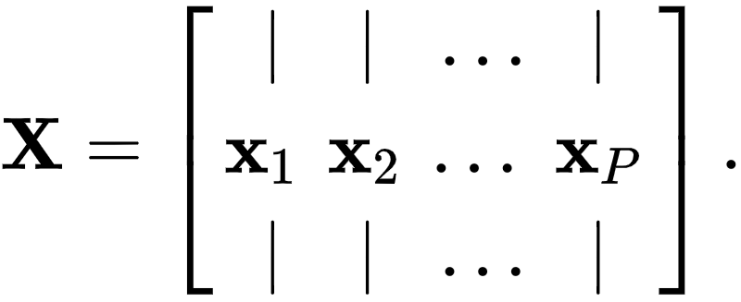
Stacking these user-rating vectors column-wise gives us our ratings matrix that we wish to complete
In order to complete a sparsely populated ratings matrix effectively - because the data we are aiming to fill in is literally missing - we have no choice but to make assumptions about how users' tastes behave in general.

Slide 12
The most common / simplest assumption we can make - and the one we discuss here - is that every user's tastes can be expressed as a linear combination of some small set of fundamental user taste-profiles.
For example, in the case of movies these profiles could include the prototypical romance movie lover, prototypical comedy movie lover, action movie lover, etc.,

Slide 13
The relatively small number of such categories or user types compared to the total number of users or movies / products / etc., in a ratings matrix, provides a useful framework to intelligently guess at the ratings matrix's missing values.

Slide 14

How does this assumption help us complete the ratings matrix? In order to find out we need to translate this intuitive assumption into mathematics.
When stated mathematically this assumption says that there are some set of K < N prototypical user-rating profile basis vectors so that we can express (approximately) every complete user-profile vector (given also the ideal weights in each linear combination) as

Slide 15


If we stack our basis vectors together columnwise into a matrix this line above can be communicated more compactly as

Slide 16


From here we could then propose to square the difference of each desired approximation above and sum the result (which would give precisely the Least Squares cost function for PCA discussed in the previous Section).
But remember in the case of Recommender Systems we only have entries of belonging to the index set . For each p we will denote the desired approximation over only this index set as

Slide 17
Squaring the difference between both sides of the above we can then form a Least Squares cost function for learning the parameters of our Recommender System (that closely mirrors the one we derived for PCA in the previous Section) as
We can call this the Recommender Systems Least Squares cost function.

Slide 18
Note from here it is not possible, as we did with PCA in the previou Section, refine our pursuit to orthogonal bases (a pursuit we saw previously that led to the autoencoder and - eventually - the classic PCA solution) since we do not have access to every element of the data.

Slide 19
Optimizing the Recommender Systems model

Slide 20
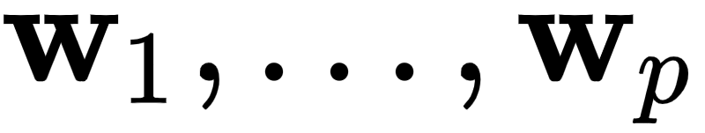

So far we have seen how the setup and cost function of the linear Recommender Systems model mirrors PCA very closely.
Now we discuss how to minimize the Least Squares cost function above in order to recover optimal settings for our parameter vectors and
In the case of PCA, we saw in Section 8.3 how the additional assumption that our basis is *orthonormal* allowed us to derive mathematically simple forms for our ideal parameter vectors.

Slide 21
However here the additional wrinkle of the Recommender Systems model - that we only have access to data whose indices lie in the set - prohibits similar calculations.
Thus in short we must rely on an iterative method for learning ideal parameters here like gradient descent or coordinate / block-coordinate descent.
Here we show a few simple examples of minimizing the Recommender System Least Squares cost via gradient descent.

Slide 22
Example: Minimizing the Recommender Systems Least Squares cost function by gradient descent

Slide 23
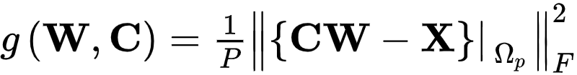

Below we write a `Python` implementation - called `least_squares` - of the Recommender Systems Least Squares cost detailed above.
For the sake of computational efficiency (to avoid explicit for loops) we implement the cost in its matrix form
Here we have stacked the weight vectors together into a matrix column-wise precisely as done with and .

Slide 24


Notice a few features of our implementation below.
First note that we pack both variable matrices and into a single list as `w = [C,W]` - and pass this list of matrices in to the function as input.
Second notice the index set `Omega` in line `9`, which contains known values of the data matrix .
Here in line `9` we literallly use this index set to sum up and square only the values in these indices from the difference .

Slide 25
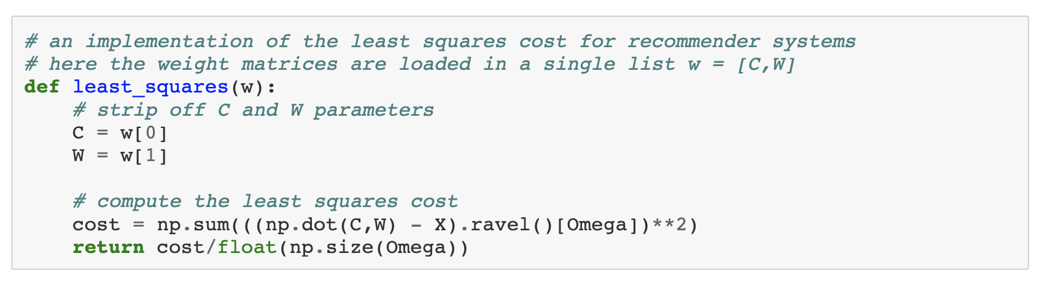

Slide 26
Now we construct a simulated ratings matrix for our tests.
This dataset - created via the ``make_random_test_matrix`` below creates a random ratings matrix of any desired size with integer entries in the range 1 to 5.
Then a user-defined percentage ``remove_perc`` of the entries of this matrix is removed, simulating an incomplete ratings matrix.
We first use it to create a small simulated ratings matrix with P = 10 and N = 100, with 75% of its entries removed.

Slide 27

Below we use our functionality to make a simulated test ratings matrix of size , and that has 75% of its entries removed.
We then run our algorithm on this matrix and plot the cost function history to make sure everything is running properly.
Here we will use K = 5 basis elements, half of the number used in generating the data.
Remember: the cost function history here is showing only our approximation to the known entries of the ratings matrix, whose indices lie in the set .

Slide 28
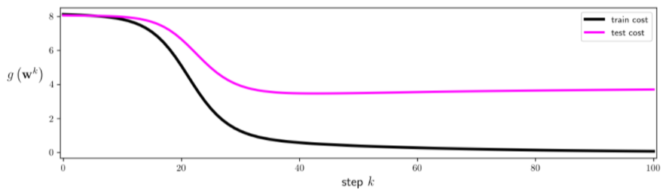

Slide 29
Now, to get a sense of how well we can learn entries in the matrix we did *not* have to begin with we run the same experiment as above.
Only now over a range of values for K=1,...,9 and plot the cost function value on a) only the values we are given and b) the entire original matrix.
Afterwards we plot both cost function histories.

Slide 30
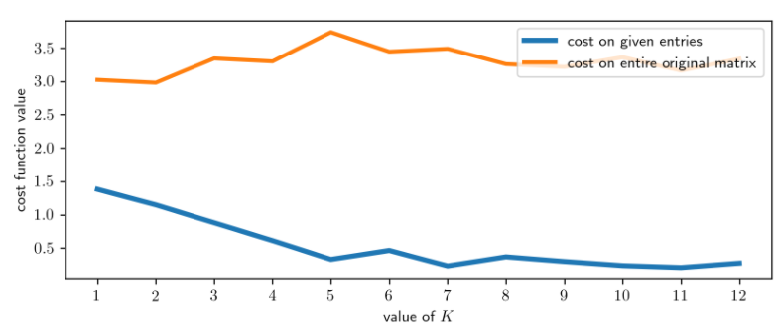

Slide 31
The sort of behavior seen here - where the cost value on the full original matrix reaches a minimum for some intermediary value of K - is quite common.
This is due to the fact that as we increase K here we begin - after a certain value (here K = 2) - to fit very well to our known entries at the expense of generalization (i.e., we begin to fit worse to values we cannot see).
This overfitting problem is a common one we will address more systematically in the next Chapter.

